Slide 1
4.1: Angles and Their Measures
MATH 1550 - Precalculus

Slide 2
Angles and Their Measure
Terminal Side
An angle is formed when a ray is rotated about its vertex.
Angle
Vertex
Initial Side

Slide 3
Positive and Negative Angles
Positive Angle
Negative Angle
Measured counterclockwise
Measured clockwise
Negative
Positive

Slide 4
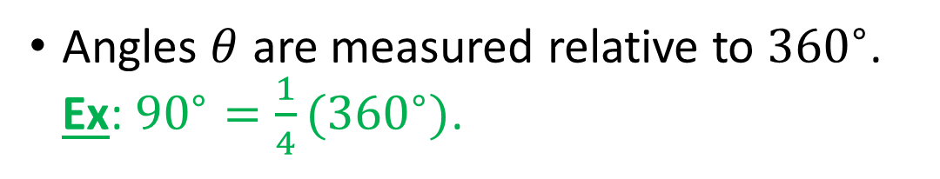
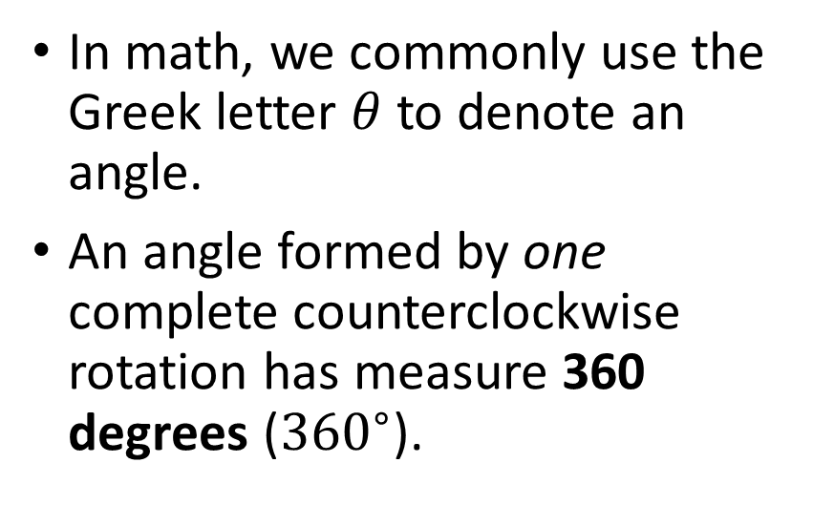

How Do We Measure Angles?
In math, we commonly use the Greek letter $θ$ to denote an angle.
An angle formed by one complete counterclockwise rotation has measure 360 degrees (${360}^{∘}$).
$$θ$$
Angles $θ$ are measured relative to ${360}^{∘}$. Ex: ${90}^{∘}=\frac{1}{4}({360}^{∘})$.

Slide 5




Some Important Angles
Right Angle
Straight Angle
Measures ${90}^{∘}$
Measures ${180}^{∘}$
$${90}^{∘}$$
$${180}^{∘}$$

Slide 6




Some Important Angles
Acute Angle
Obtuse Angle
Between $0^{∘}$ and ${90}^{∘}$
Between ${90}^{∘}$ and ${180}^{∘}$
$${90}^{∘} < θ <{180}^{∘}$$
$$0^{∘} < θ <{90}^{∘}$$

Slide 7








Angle Geometry
If the sum of two positive angles is ${90}^{∘}$, they are complementary.
If the sum of two positive angles is ${180}^{∘}$, they are supplementary.
$$α + β = {180}^{∘}$$
$$α + β = {90}^{∘}$$
$$β$$
$$β$$
$$α$$
$$α$$

Slide 8





Radian Measure
If a central angle $θ$ in a circle with radius $r$ intercepts an arc on the circle of length $s$ (the arc length), then the measure of $θ$ in radians is given by
$θ=\frac{s}{r}$.
IMPORTANT: $s$ and $r$ MUST be in the same units!
$$r$$
$$s$$
$$θ$$
$$r$$

Slide 9

Conversion Between Radians and Degrees
One full rotation in a circle is ${360}^{∘}$, or $2π$ radians.
Consequently, ${180}^{∘}=π$ rad (radians) .
To convert degrees to radians, multiply by $\frac{π}{{180}^{∘}}$.
To convert radians to degrees, multiply by $\frac{{180}^{∘}}{π}$.

Slide 10


Angles in the Cartesian Plane
Terminal Side
An angle $θ$ is said to be in standard position if its initial side corresponds to the x-axis, and its vertex is the origin.
$$θ$$
Vertex
Initial Side

Slide 11



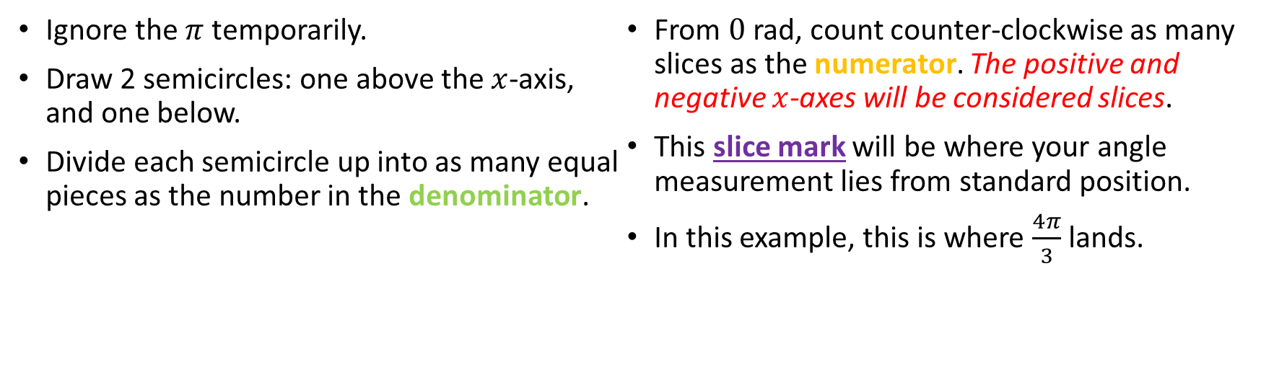






How to “read” radian measure
$$π$$
Ignore the $π$ temporarily.
Draw 2 semicircles: one above the $x$-axis, and one below.
Divide each semicircle up into as many equal pieces as the number in the denominator.
From $0$ rad, count counter-clockwise as many slices as the numerator. The positive and negative $x$-axes will be considered slices.
This slice mark will be where your angle measurement lies from standard position.
In this example, this is where $\frac{4π}{3}$ lands.
$$4$$
$$3$$
2
1
$$\frac{ π}{3}$$
$$\frac{ π}{3}$$
3
0
$$π= \frac{ π}{3}$$
6
$$\frac{ π}{3}=2π$$
4
5
$$\frac{ π}{3}$$
$$\frac{ π}{3}$$

Slide 12
Coterminal Angles
To find the measure of the smallest nonnegative coterminal angle of a given angle measured in degrees:
If the angle is positive, subtract 360⁰ until the resulting angle measure is positive and less than or equal to 360⁰.
If the angle is negative, add 360⁰ until the resulting angle measure is nonnegative and less than or equal to 360⁰.
Any angle is coterminal with itself. Why?
Two angles in standard position are said to be coterminal if they have the same terminal side.

Slide 13
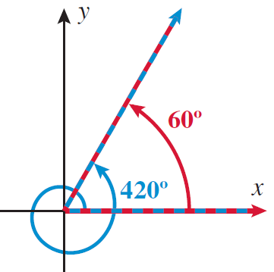
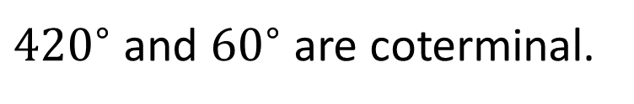
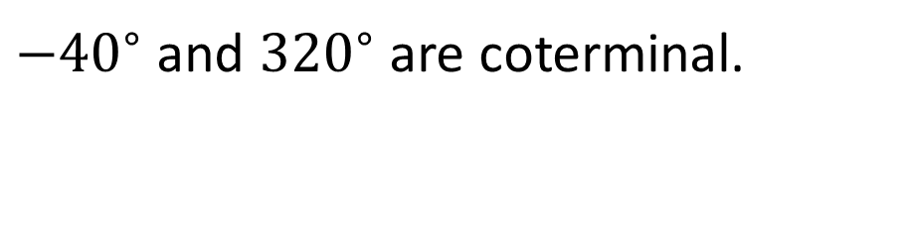


${−40}^{∘}$
${320}^{∘}$
$−{40}^{∘}$ and ${320}^{∘}$ are coterminal.
${420}^{∘}$ and ${60}^{∘}$ are coterminal.

Slide 14
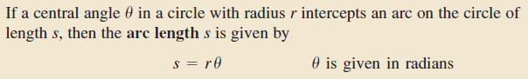
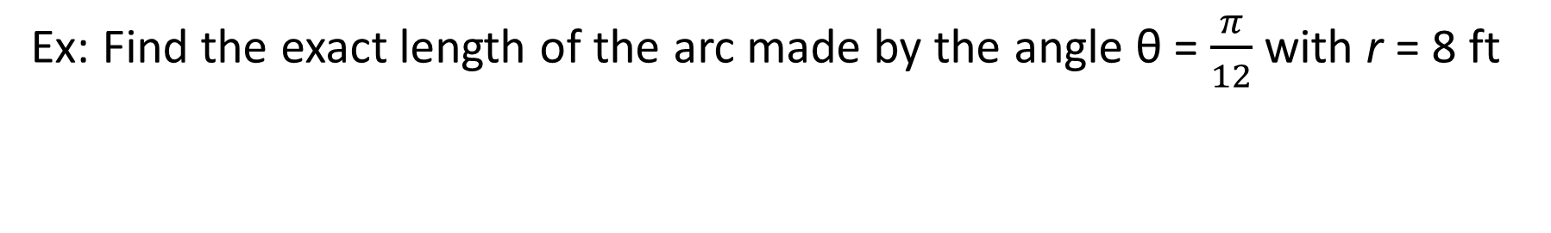
Arc Length
Ex: Find the exact length of the arc made by the angle θ = $\frac{π}{12}$with r = 8 ft

Slide 15
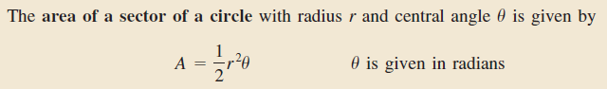

Area of a Sector of a Circle
Ex: If a sprinkler head rotates ${180}^{∘}$ and has enough pressure to keep a constant 30-ft spray, what is the area of the sector of the lawn it can water, rounded to the nearest square ft?

